Slide 1

Enabling Town Slough
Presentation:
Geoff Dennis
Natasha Berthollier
Rex Haigh
Film and discussion:
Members and staff of EMBRACE therapeutic community
www.EnablingTownSlough.com

Slide 2
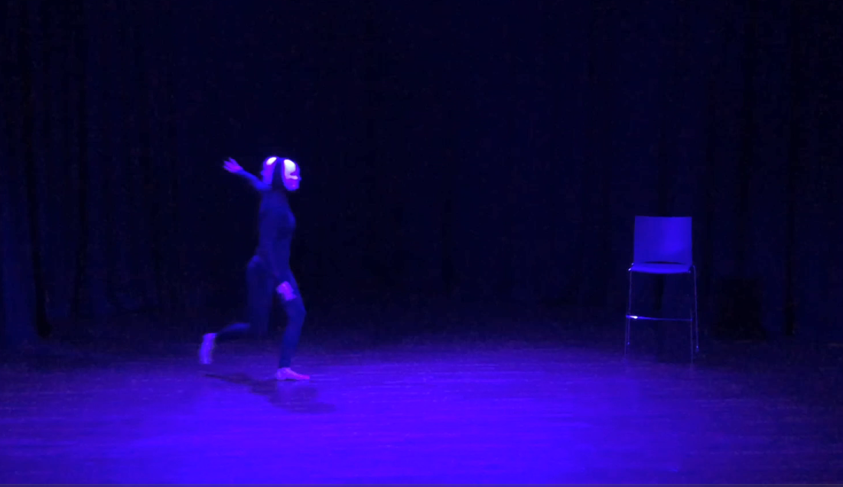
And in the naked light I saw
Ten thousand people, maybe more
People talking without speaking
People hearing without listening

Slide 3

Geoff Dennis, Head of Slough Mental Health
#EnablingTownSlough
@EnablingSlough

Slide 4


Slide 5


Slide 6

Slough

Slide 7
Slough: a deprived town near London
Population 164,000
Deprivation Index = 93 (high)
Transient population with >100 languages
Unemployment, dual diagnosis, comorbidities
Covid 328/100,000 = ‘tier 3’ with most severe restrictions

Slide 8
What it is all about…
Walls and Fields
Salutogenesis
Community Asset Based Approach
Co-production
Relational integration across the town
Health as a SOCIAL MOVEMENT

Slide 9
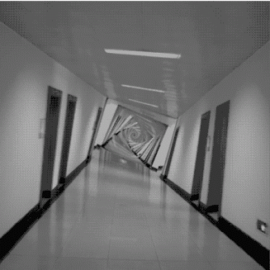

Slide 10
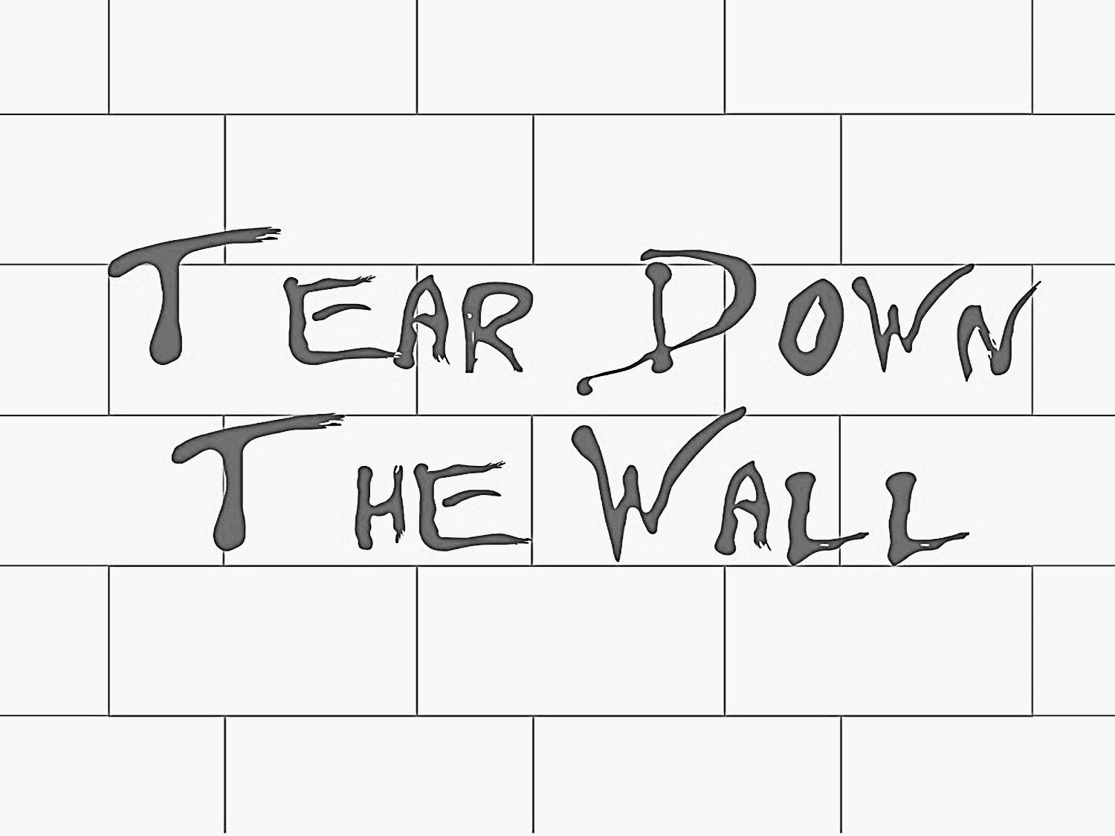

Slide 11
BEING
and
BELONGING

Slide 12
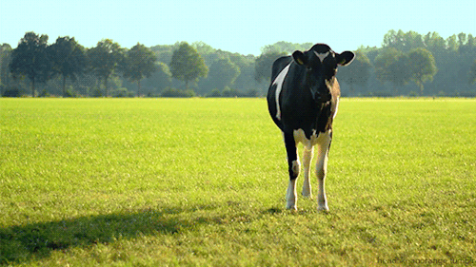

Slide 13
Salutogenesis
Salutogenesis is a term coined by Aaron Antonovsky (1979), a professor of medical sociology. The term describes an approach focusing on factors that support human health and well-being, rather than on factors that cause disease (pathogenesis).

Slide 14
Salutogenesis v Pathogenesis
Health promotion
Salutogenesis
“HEALTH-EASE”
WELL-BEING
FUNCTIONING
DISEASE
ILLNESS
SICKNESS
Pathogenesis
Disease prevention, cure & care

Slide 15
Community Asset-Based Approach
Requires a paradigm shift in mind-set for everyone involved
Sees individuals and communities as the co-producers of health and well-being, rather than the recipients of services.
Empowers communities to control their own futures.

Slide 16
What is a health asset?
“A health asset can be defined as any factor (or resource), which enhances the ability of individuals, groups, communities, populations, social systems and/or institutions to maintain and sustain health and wellbeing and to help reduce inequalities”
(Morgan & Ziglio, 2007)

Slide 17
Co-production
A Shared Vision for the Future
Principles:
Being and Belonging (social connectedness)
Taking an asset-based approach (social value)
Building on service-users’ existing capabilities
Opposite to Deficit Model
Peer network (Whole town approach)
Working with people, not on people.

Slide 18
Slough Mental Health Services:
Enabling Town Slough
Eight years of developing co-produced asset-based services:
HOPE Recovery College
THE CIRCLE WORKS
HOPE House(Supported Living)
HOPE Place (Supported Living)
ASSiST (Alternative to admission)
EMBRACE (Group Therapeutic Programme)
Peer Mentors
Leading co-production across the county
BRAVE (Domestic abuse programme)
Trail Blazers & Wellbeing Practitioners
ENABLING TOWN SLOUGH website

Slide 19
Slough Mental Health Services:
Enabling Town Slough
Relational practice and integrated connectivity:
A co-produced Service Philosophy
#StrongerTogether:
“I am not my diagnosis…see my wellness.”
Gives ownership and social value to all involved
#NotAlone
Loneliness and Isolation Campaign

Slide 20

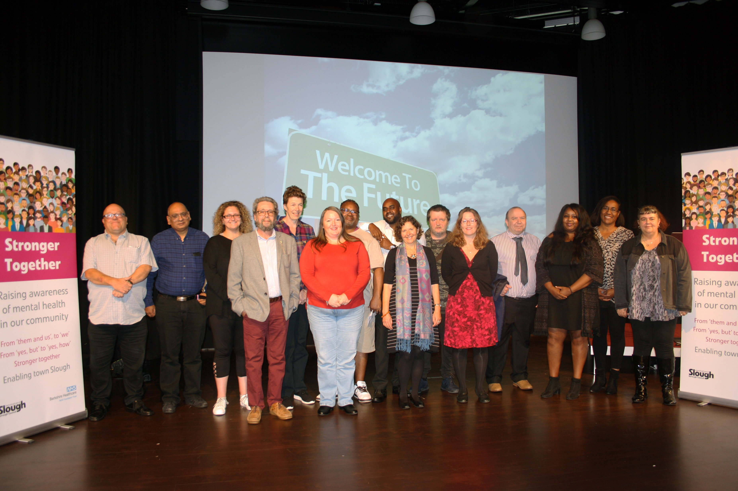


Slide 22
ASSiST and EMBRACE
ASSiST (ing) …Relational Practice
EMBRACE (ing) …Co-Production
Natasha Berthollier, Consultant Psychologist
Natasha.Berthollier@berkshire.nhs.uk
#EnablingTownSlough
@EnablingSlough

Slide 23
ENABLING TOWN SLOUGH
A…
Enabling
Systemic
Formulation-driven
Co-produced
Asset-based
Relational
Recovery-focused
Trauma-informed
Bio-Psycho-Social
...model

Slide 24
We work with:
East Berkshire (population = 432k)
People who do not
‘fit the boxes’
Several treatments previously tried
‘Revolving-door’ hospital admissions
Non-psychotic
Often personality disorders
Complex trauma
High comorbidity
Dual Diagnosis
High risk to self

Slide 25
Joiner’s Interpersonal Model of Suicide (2005)

Slide 26
Treatment Care Plan
Based on Joiner (2005)
Thwarted Belongingness
Perceived Burdensomeness
Acquired
Capability
Social Connectedness
Relationships as the treatment
Relational Practice
A sense of Purpose
Co-production as the treatment
Asset-Based Approach
Individually Tailored
Psychosocial evidence-based treatments

Slide 27
Individually tailored psychological evidence-based treatments
Initial engagement and
extended assessment of needs:
Assertive-outreach
Stabilisation and engagement
BioPsychoSocial Formulation
Co-produced Safety planning
GP triangulation
Carers/Systemic sessions
Emotion regulation, Distress tolerance,
Sleep hygiene, Urge management etc.
Motivational Interviewing
Orientation to group programme and peer mentors

Slide 28
Social Connectedness:
Co-produced EMBRACE

Slide 29
Social Connectedness
EMBRACE Therapeutic Community
Relationships as the treatment.
EMBRACE group hub
Four phases, two years
Ward EMBRACE
Psycho-social /Psycho-educational groups
Future-focused psychological sustainability and resilience
A passionate sense of ownership
Relational Practice
A sense of belonging to the group and
wider community of Enabling Town Slough

Slide 30
A Sense of Purpose
Co-production as the treatment
‘Asset-Based’ as the approach
On-going co-production
A sense of agency and self-efficacy
Phased increased responsibility ‘roles’
Peer Mentors
HOPE Recovery College
Wider community
Voluntary, Employment, Training
Links to voluntary sector
Returning as volunteers and paid staff

Slide 31
Outcome Data (First cohort)
N= 103
 | 12 months Pre-ASSiST | 12 months Since Start Date of ASSiST
Number of admission episodes | 173 | 15
Bed Days | 4786 | 312
Cost of Bed days | £1,550,664.00 | £101,088.00
CRHTT | 4248 | 1199
A&E | 203 | 37

Slide 32
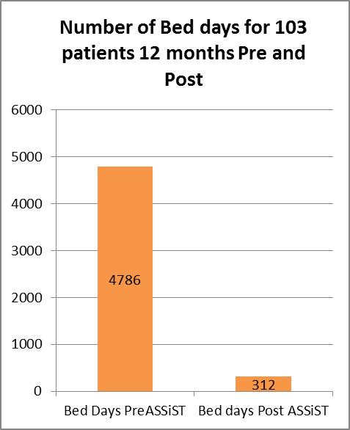
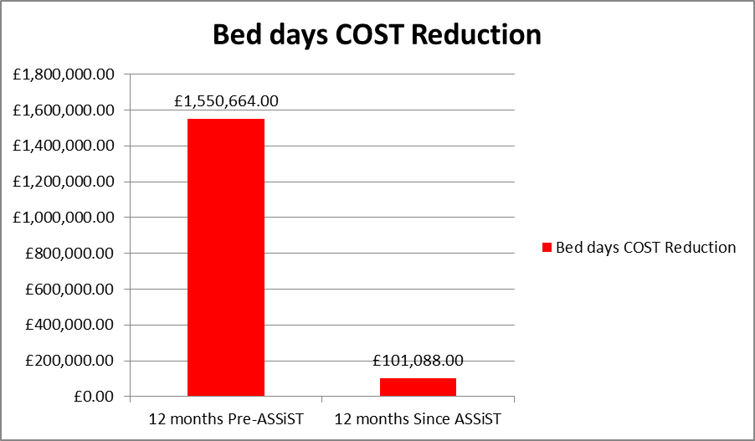
Bed Days and Cost Reduction

Slide 33
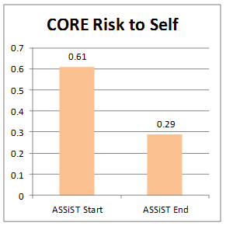
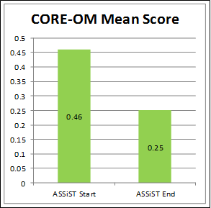

Slide 34
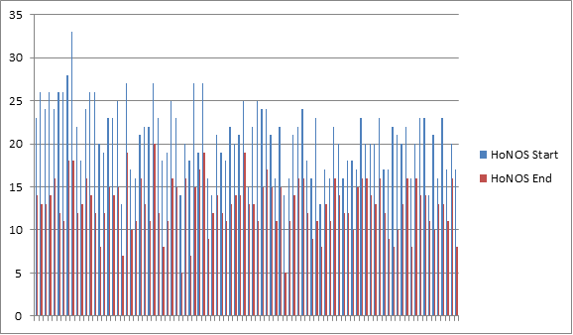
HoNOS Compared Scores
Health of The Nation Outcome Scale (HoNOS) compared scores for the 103 patients pre and post ASSiST.

Slide 35
A new form of therapeutic community:
‘A felt sense’
More fun for all involved
Flexibility to ever changing new demands
More able to use co-creation
A different nature of power relationships
A greater sense of belonging: with continuity
Innovative use of all community resources
Relational integration across the town
‘Once a visitor, always a member’
Health as a SOCIAL MOVEMENT

Slide 36
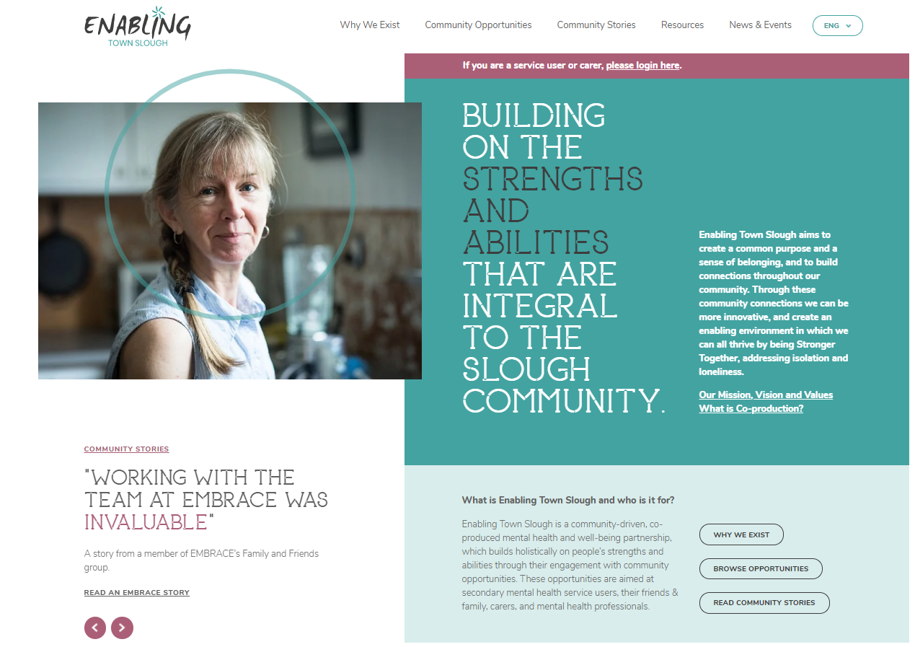
www.EnablingTownSlough.com

Slide 38
Therapeutic Communities:
modified for the 21st century
Dr Rex Haigh,
Consultant Medical Psychotherapist, Berkshire
Community of Communities and Enabling Environments, Royal College of Psychiatrists, London
rexhaigh@nhs.net
#EnablingTownSlough
@EnablingSlough

Slide 39
The BRITISH DEMOCRATIC TC model
Non biomedical model: diagnosis – medication – risk
Flattened hierarchy: little sense of ‘us and them’
Living-learning experience: everything is treatment – including playfulness and fun
Culture of enquiry: everything can be questioned
Shared decision-making: one person one vote, including admission and discharge (where possible)
Responsibility: eg rules and boundaries, meals and food, money and extra activities
Peer therapy: therapists rarely offer advice or interpretations
No individual therapy: everything is done in groups
Non-residential TCs where ‘real life’ is part of the whole therapy experience

Slide 40
Reduced ‘dose’ in NHS
Closure of residential units
  None after 2010, except Cassel Hospital
5 days per week format (‘full time Day TCs’)
  Monday to Friday, 9.30-3.30pm – common in 1990s
Reduced to 3 days per week (‘Day TC’)
  Two days for staff to do other activities,
  eg assessment and preparation groups – in early 2000s
Then 1 day ±1 group format (called ‘Mini-TCs’)
  Core staff only spend one day per week in the TC – later 2000s
Latest variant = 2½ hours per week (‘Micro-TC’)
  But the ‘TC’ is in the head – the experience – and many other activities happen during the week, without the staff - 2014

Slide 41
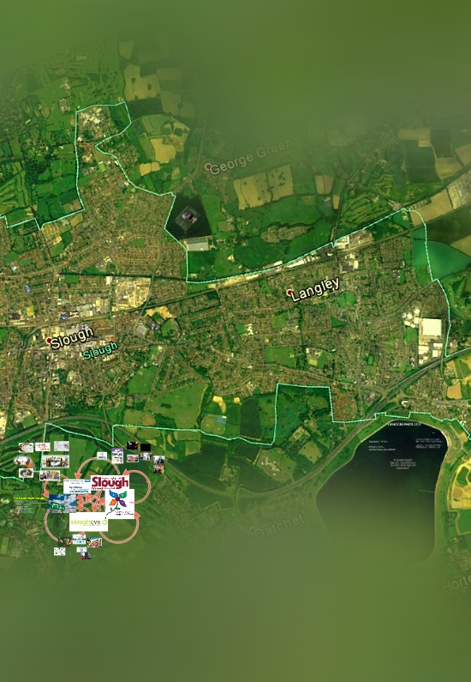
Whole Town TC
Using TC principles and methods outside the TC itself
In the tradition of:
What Basglia and the Gorizia equipe were trying to do (1970s)
And Maxwell Jones in Dingleton (1970s)
And Alberto Fergusson in Sopo, Bogota, and others elsewhere
And our micro/macro TC in Slough

Slide 42
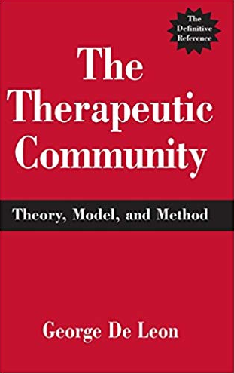
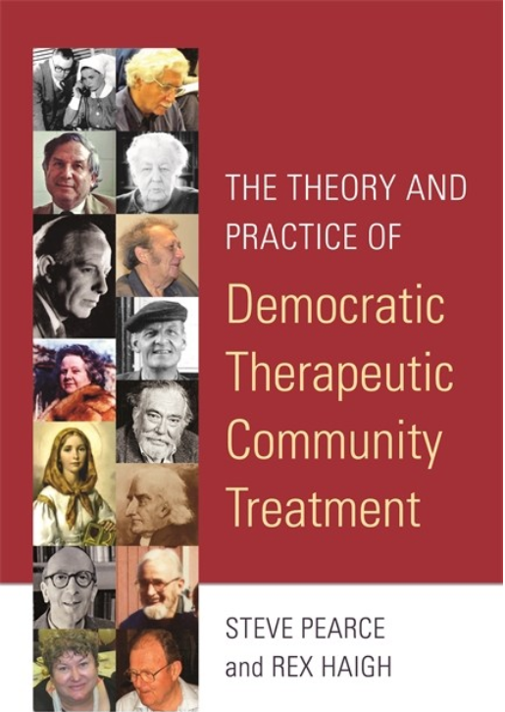

Slide 43
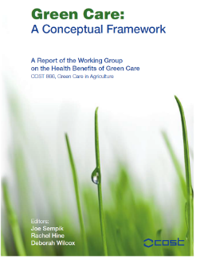
Greencare – EU COST 866
cooperation by scientists brought together under the COST 2011 (European Cooperation in Science and Technology) programme.
describes & defines green care; sets it within the context of theoretical and practical frameworks (including those of psychology, psychotherapy, health promotion, social inclusion and others).
Notes:
.

Slide 44
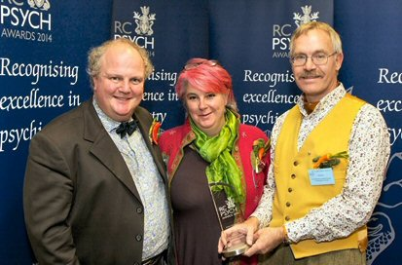
Greencare – Growing Better Lives
“Greencare is a holistic and economically viable alternative to treatment with medication and hospitalisation.
Sustainability is about connecting people to each other and to nature, helping people to see that there is a life worth living, and on a planet that is worth living on.”
Royal College of Psychiatrists Sustainability Award, 2014
Inspirations – Transition Towns, Permaculture, EU COST Action, critical psychiatry, etc…

Slide 45
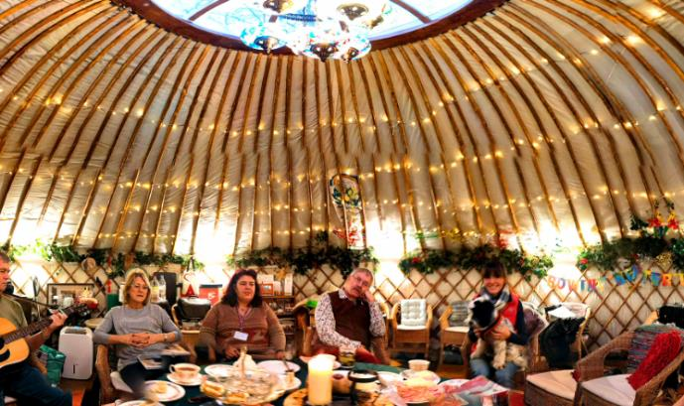
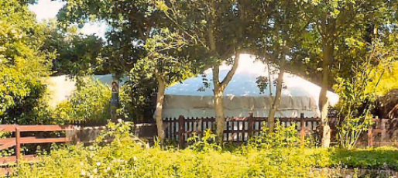
Greencare in Slough
Ecotherapy
For people who aren’t helped by mainstream services
1x weekly TC-style groups
Grow & cook own food
Various other activities chosen in community meetings
Special events
Blog
Plant emoticon scale

Slide 46
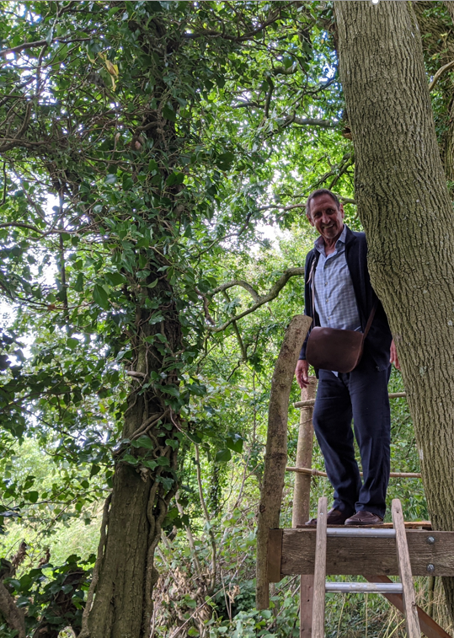
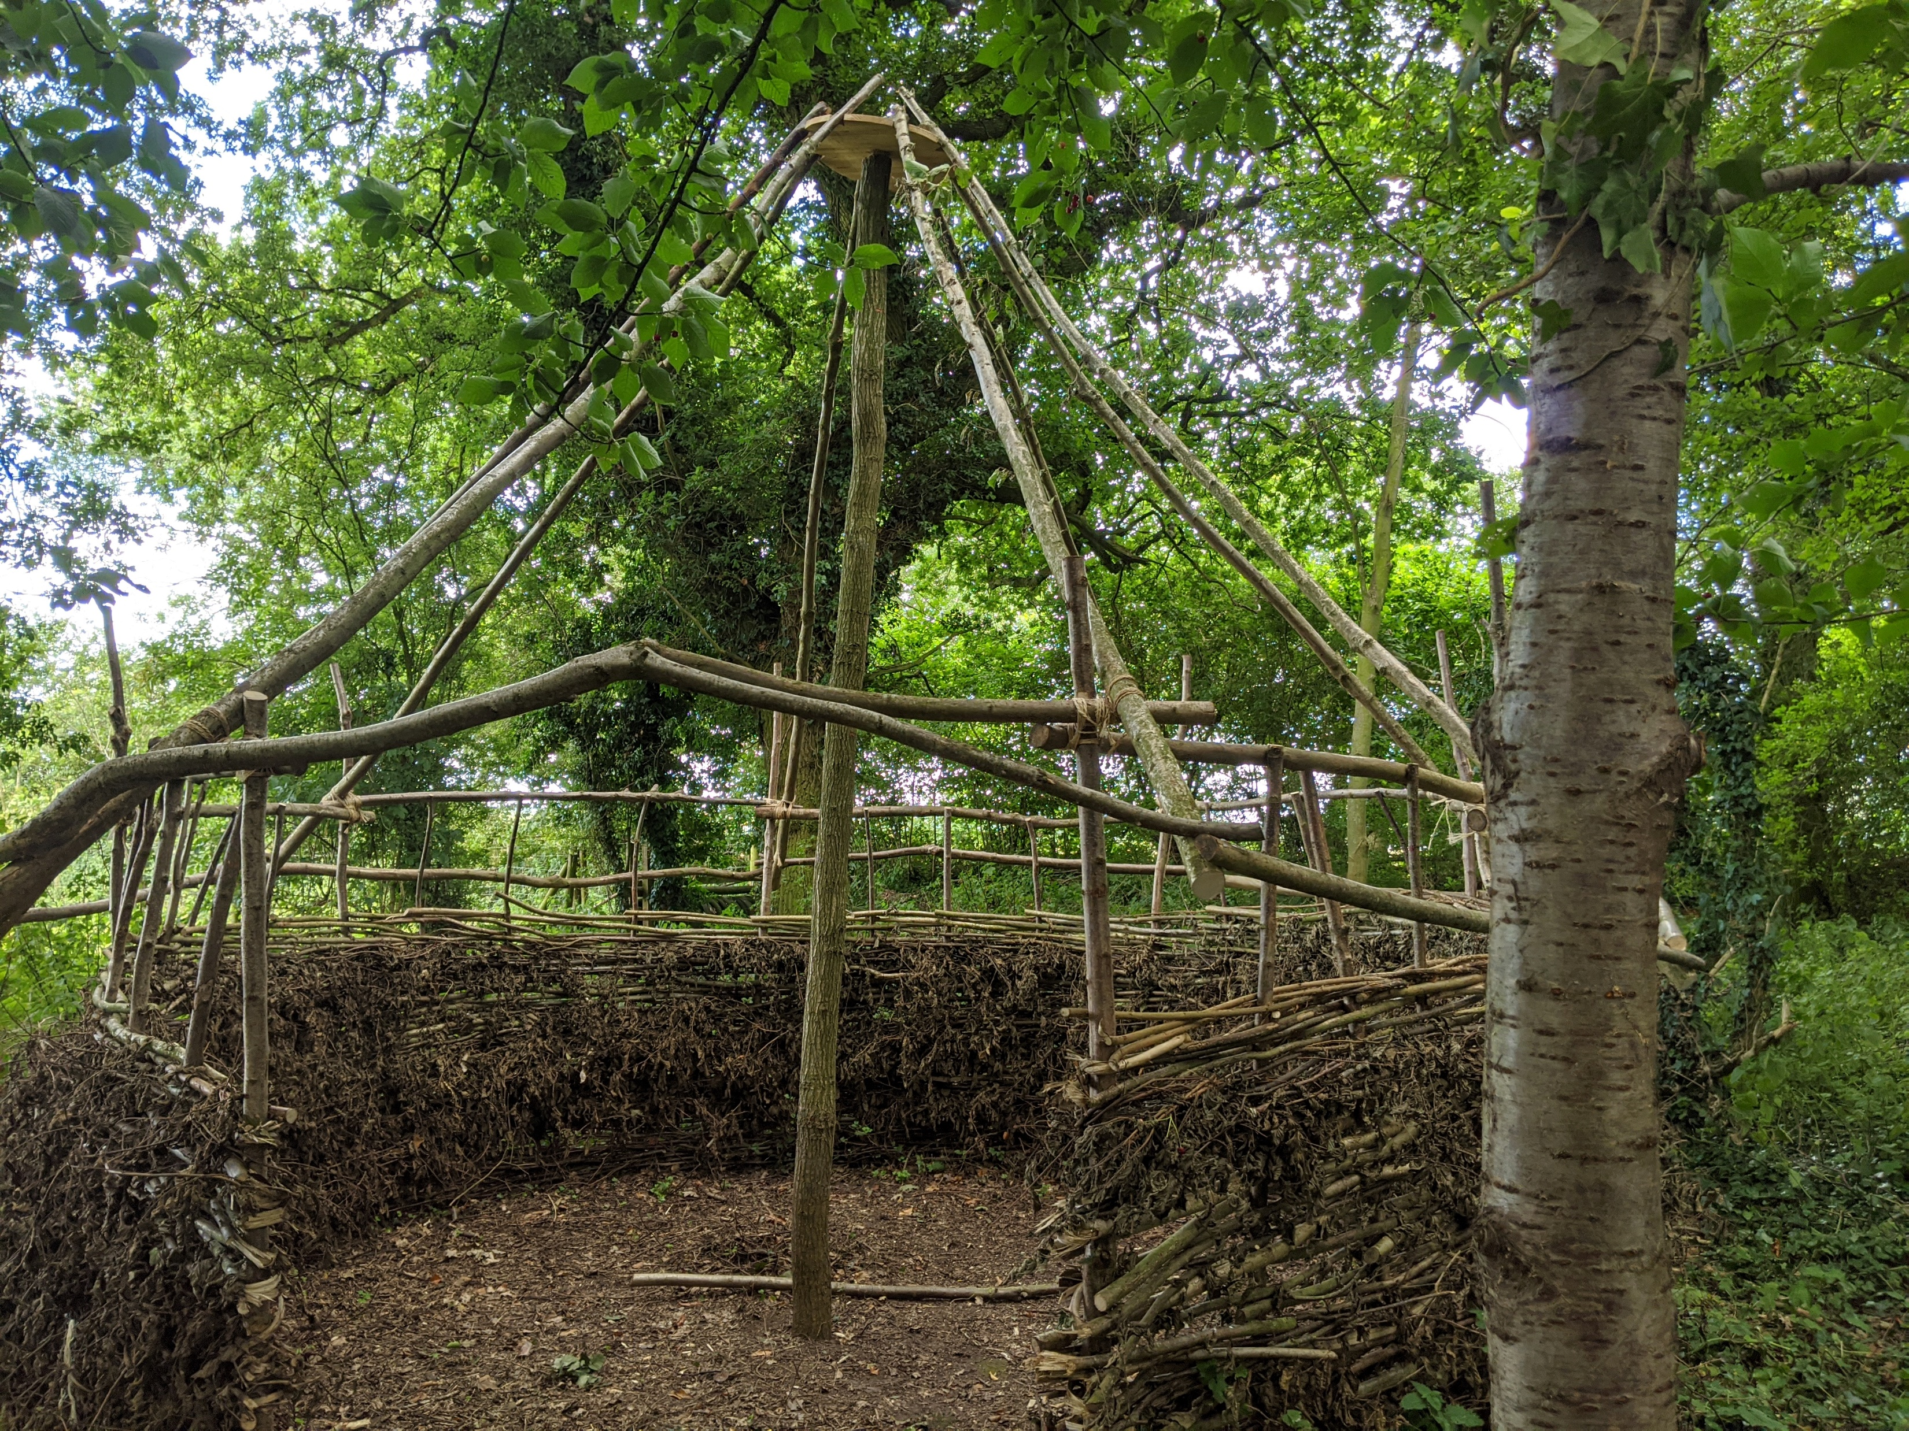
Greencare in
Wiltshire

Slide 47
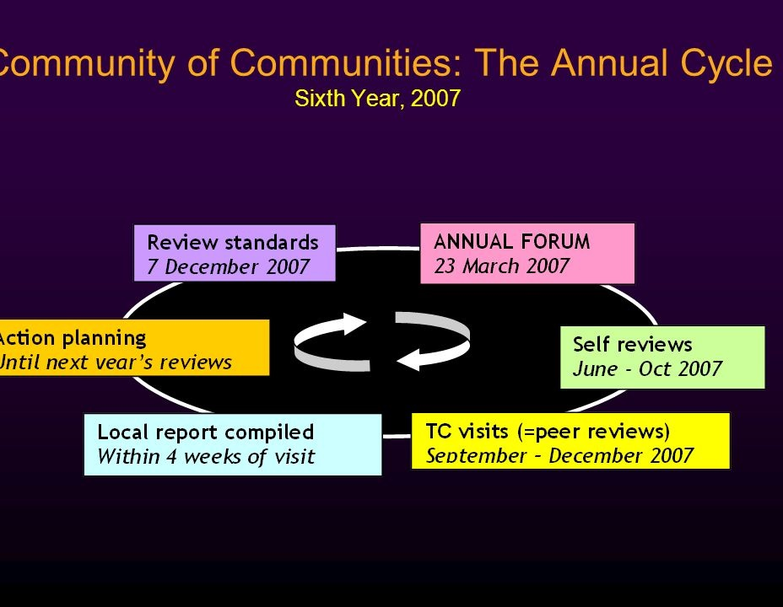
Quality Assurance:
Community of Communities
The Community of Communities
Goes back to 1970s ATC with visits to each other’s TCs
Visits to learn from each other
Now part of much larger formal audit programme
But democratic, relational values
An educational and enjoyable process
Has been replicated in Italy (‘Visiting Project’) and Australia

Slide 48

Enabling Environments and
‘the TC in the head’
Therapeutic ENVIRONMENTS – quality of relationships
PIEs for homelessness hostels
PIPEs for prisons
Therapeutic child care
All of them are POSITIVE ENVIRONMENTS

Slide 49
Enabling Environment Standards
BELONGING
The nature and quality of relationships are of primary importance
BOUNDARIES
There are expectations of behaviour and processes to maintain and review them
COMMUNICATION
It is recognised that people communicate in different ways
DEVELOPMENT
There are opportunities to be spontaneous and try new things
INVOLVEMENT
Everyone shares responsibility for the environment
SAFETY
Support is available for everyone
STRUCTURE
Engagement and purposeful activity is actively encouraged
EMPOWERMENT
Power and authority are open to discussion
LEADERSHIP
Leadership takes responsibility for the environment being enabling
OPENNESS
External relationships are sought and valued

Slide 50
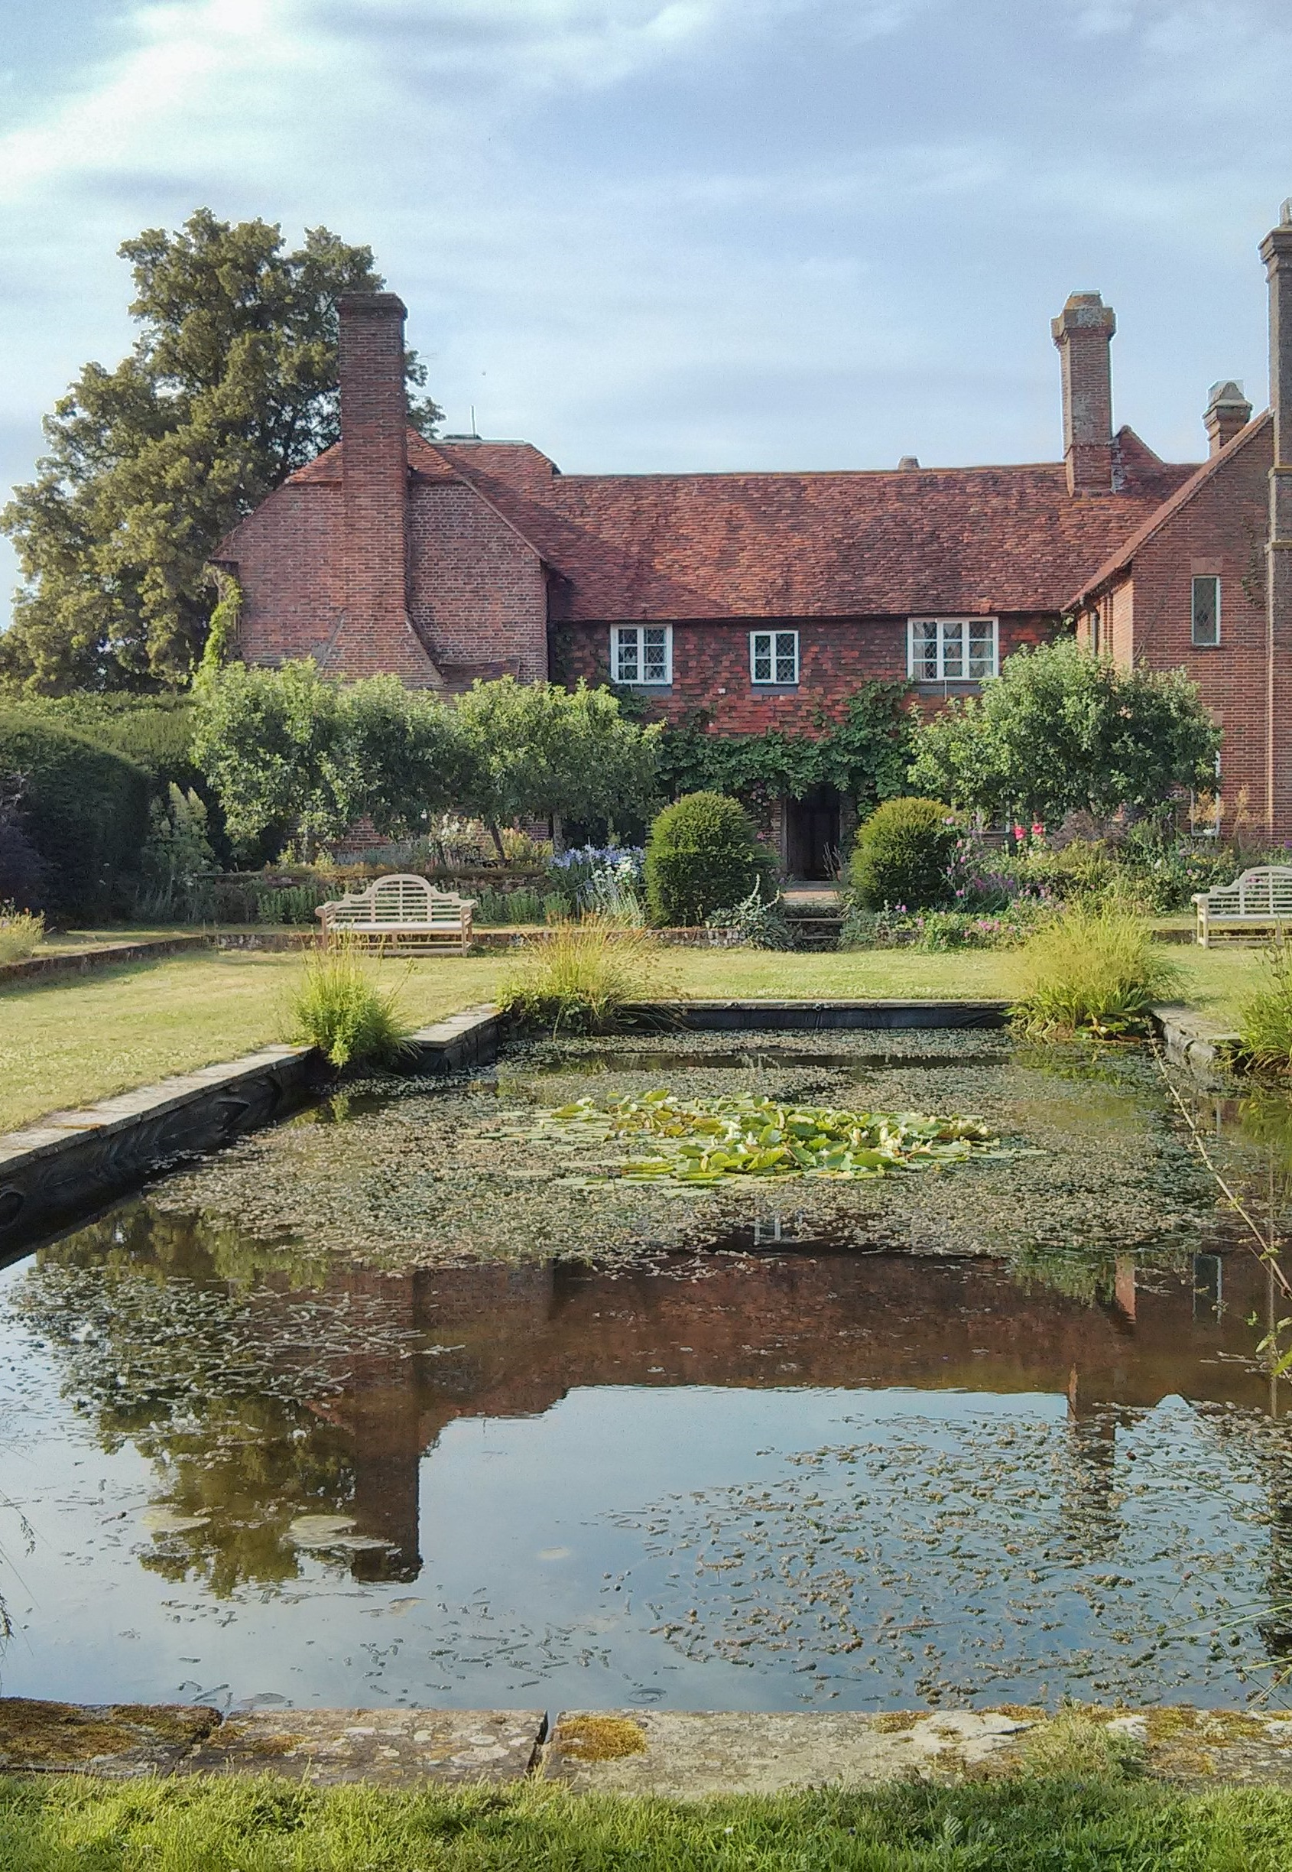
Transient Training TC:
‘Living-Learning Experiences’
Residential ‘LLEs’
3 days only – living as a TC in a beautiful place
UK and Italy for >20 years – now also India and Portugal, with others planned
For staff ‘what it is like to be a patient’
Intensive group work
The whole group is responsible for what happens
This includes choice of small groups, meals together, leisure time, managing emergencies & crises
…And having a useful and creative time together!

Slide 51
The way forward?
Locally…
Globally…
Modified TCs
Greencare
Community of Communities
Enabling Environments
Experiential training
Open Dialogue
ICD-11
Power-Threat-Meaning framework
International Association for Psychiatric Drug Withdrawal

Slide 52
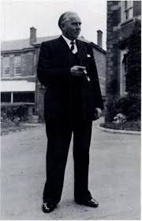
Problems with mental health services:
World Health Organisation - 1953
'The Third Report of the
Expert Committee on Mental Health’.
'The most important single factor in the efficacy of the treatment given in a mental hospital appears to the Committee to be an intangible element which can only be described as its atmosphere, and in attempting to describe some of the influences which go to the creation of this atmosphere, it must be said at the outset that the more the psychiatric hospital imitates the general hospital as it at present exists, the less successful it will be in creating the atmosphere it needs. Too many psychiatric hospitals give the impression of being an uneasy compromise between a general hospital and a prison. Whereas, in fact, the role they have to play is different from either; it is that of a therapeutic community.'
The constituents of this atmosphere include the following:-
1. Preservation of the patient's individuality
2. The assumption that patients are trustworthy.
3. That good behaviour must be encouraged.
4. That patients must be assumed to retain the capacity for a considerable degree of responsibility and initiative
5. The need for activity and a proper working day for all patients.
‘The creation of the atmosphere of a therapeutic community is in itself one of the most important types of treatment which the psychiatric hospital can provide.'
T P Rees,
President RCPsych 1957-58

Slide 53
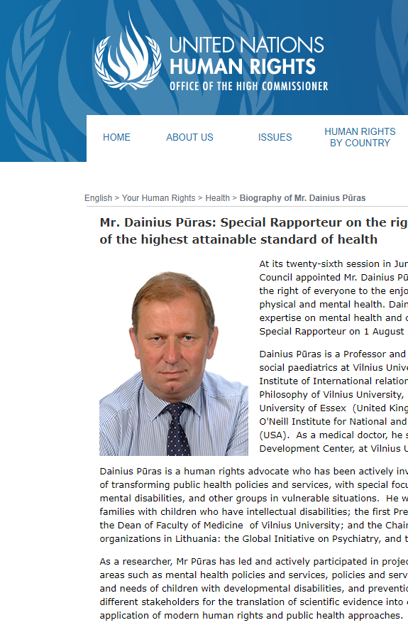
Back to the Future!
United Nations Special Rapporteur - 2017
“Mental health policies and services are in crisis - not a crisis of chemical imbalances, but of power imbalances.”
“We need bold political commitments, urgent policy responses and immediate remedial action.”
“We need little short of a revolution in mental health care to end decades of neglect, abuse and violence.”

Slide 54
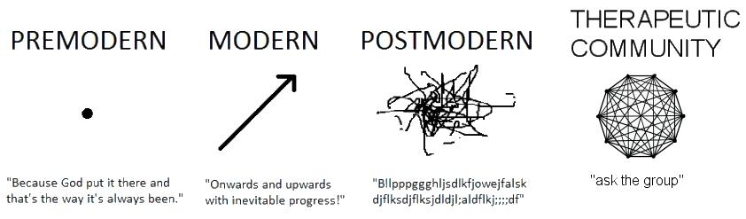
Postmodernity …and beyond?

Slide 55
So… what is this ‘Golden Thread’?
We call it ‘relational practice’ and
‘democratic mental health’
We have been doing it in TCs for many
years, and it has always existed in many other
places too
It means prioritising ‘human relations’ (aka compassion)
above ‘organisational requirements’ (of the economic system)
There are many other movements that are working for the same ends – a world where priorities are different

Slide 56

#EnablingTownSlough
@EnablingSlough

Slide 58
Break
1100 EMBRACE film

Slide 59
A short film
By members of the EMBRACE community
20 minutes
To discuss four themes (5 minutes each):
  CO-PRODUCTION
  What does ‘co-pro’ mean?
  How have you been involved? What have you done?
  RELATIONAL PRACTICE
  What are the relationships like in the groups?
  What is different from other places?
  VALUES
  What are the values that are important to you in this TC?
  How do we use them in the groups?
  ACROSS THE TOWN
  What does ‘Enabling Town Slough’ do?
  How does it relate to the website?

Slide 60
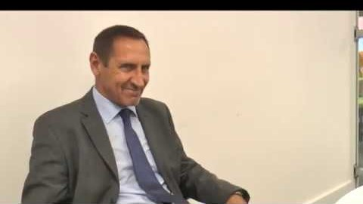

Slide 61
1120 Q&A

Slide 62

Mad cows?
1230 Finish

